Slide 1
What is Object-Oriented Programming?
Object-Oriented Programming (OOP) is a programming approach where we organize a program around objects rather than just functions and variables.
An object represents something from the real world.
Real-world examples:
Real World | Programming Object
Customer | Customer object
Bank Account | BankAccount object
Employee | Employee object
Product | Product object
Order | Order object
Simple idea:
Real-world entity → Object → Data + Actions
For example:
A customer has:
Name
Customer ID
Email
Phone
And can:
Place an order
Cancel an order
Make payment

Slide 2
Why Do We Need Classes and Objects?
Imagine an online store has 10,000 customers.
Without OOP, we might create many separate variables:
customer1_name = "Ali"
customer1_email = "ali@gmail.com"
customer2_name = "Ahmed"
customer2_email = "ahmed@gmail.com"
This becomes difficult to manage.
Instead, we can create a Customer class:
class Customer:
pass
Then create many customer objects:
customer1 = Customer()
customer2 = Customer()
customer3 = Customer()
Main advantage:
One class can be used to create thousands of objects.

Slide 3
What is a Class?
A class is a blueprint or template for creating objects.
Think about a building blueprint.
The blueprint describes:
Number of rooms
Doors
Windows
Structure
But the blueprint itself is not the actual house.
Similarly:
class Customer:
pass
is a blueprint.
Objects are created from this blueprint.

Slide 4
Creating a Simple Class in Python
Python uses the class keyword.
class Customer:
pass
Explanation:
class → tells Python we are creating a class.
Customer → name of the class.
pass → means there is currently no implementation.
Creating an object:
customer1 = Customer()
Now:
Customer
↓
customer1
customer1 is an object of the Customer class.

Slide 5
Creating Multiple Objects
One class can create many objects.
class Customer:
pass
customer1 = Customer()
customer2 = Customer()
customer3 = Customer()
We now have:
Customer Class
|
┌────┼────┐
↓ ↓ ↓
C1 C2 C3
Each object is independent.
Business Example
A company can use one Customer class to represent:
Ali
Ahmed
Sara
Hamza
Ayesha

Slide 6
What are Attributes?
Attributes are the data or characteristics of an object.
For a customer:
Customer
----------------
Customer ID
Name
Email
Phone
Address
For an employee:
Employee
----------------
Employee ID
Name
Department
Salary
In Python:
class Customer:
pass
customer1 = Customer()
customer1.name = "Ali"
customer1.email = "ali@gmail.com"
Now the object contains data.

Slide 7
Accessing Object Attributes
We use the dot (.) operator to access or create attributes.
class Customer:
pass
customer1 = Customer()
customer1.name = "Ali"
customer1.city = "Karachi"
print(customer1.name)
print(customer1.city)
Output:
Ali
Karachi
Important:
customer1.name
means:
Access the name attribute of the customer1 object.

Slide 8
Different Objects, Different Data
The same class can contain different information for different objects.
class Customer:
pass
customer1 = Customer()
customer2 = Customer()
customer1.name = "Ali"
customer1.city = "Karachi"
customer2.name = "Ahmed"
customer2.city = "Lahore"
Now:
print(customer1.name)
print(customer2.name)
Output:
Ali
Ahmed

Slide 9
Constructor and __init__()
Problem With Assigning Attributes Manually
Consider:
customer1 = Customer()
customer1.name = "Ali"
customer1.email = "ali@gmail.com"
customer1.city = "Karachi"
For every customer, we have to write the attributes manually.
This is inconvenient.
Python provides a special method called:
__init__()
It is commonly used to initialize an object's data when the object is created.

Slide 10
The __init__() Method
class Customer:
def __init__(self, name, email):
self.name = name
self.email = email
//def is used to define a function/method.
//__init__ is a special method that runs automatically when an object is created.
//self refers to the current object.
//name is a parameter that will receive the customer's name.
//email is a parameter that will receive the customer's email.
//: indicates that the code belonging to this method starts on the next indented lines.
Now create an object:
customer1 = Customer("Ali", "ali@gmail.com")
Python automatically calls __init__().
The values are stored inside the object.
customer1 = Customer("Ali", "ali@gmail.com")
customer2 = Customer("Sara", "sara@gmail.com") customer3 = Customer("Ahmed", "ahmed@gmail.com")
print(customer1.name)
print(customer1.email)
Output:
Ali
ali@gmail.com

Slide 11
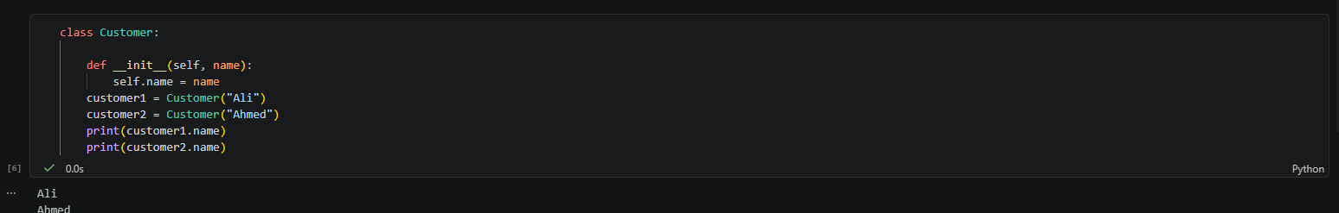
Understanding Self
self refers to the current object.
Example:
class Customer:
def __init__(self, name):
self.name = name
When we write:
customer1 = Customer("Ali")
Python stores:
customer1.name = "Ali"
When we write:
customer2 = Customer("Ahmed")
Python stores:
customer2.name = "Ahmed"
Important idea:
self allows each object to maintain its own data.

Slide 12
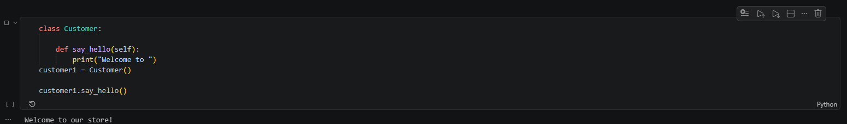
What is a Method?
A method is a function defined inside a class.
Methods represent actions that an object can perform.
Customer example:
A customer can:
Place order
Make payment
Update profile
View order
Example:
class Customer:
def say_hello(self):
print("Welcome to our store!")
customer1 = Customer()
customer1.say_hello()

Slide 13
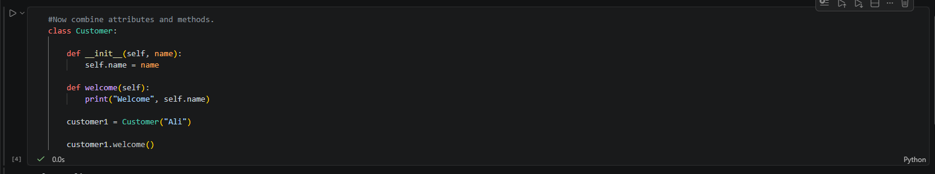
Class With Attributes and Methods

Slide 14
Business Example: Bank Account
class BankAccount:
# Constructor: runs automatically when a new BankAccount object is created
def __init__(self, holder, account_number, balance):
self.holder = holder # Stores the account holder's name
self.account_number = account_number # Stores the unique account number
self.balance = balance # Stores the starting balance
def deposit(self, amount):
# Reject invalid (zero or negative) deposit amounts
if amount <= 0:
print("Deposit amount must be positive.")
return
self.balance += amount # Add the deposited amount to the balance
def withdraw(self, amount):
# Reject invalid (zero or negative) withdrawal amounts
if amount <= 0:
print("Withdrawal amount must be positive.")
return
# Reject withdrawal if it exceeds the current balance
if amount > self.balance:
print("Insufficient balance.")
return
self.balance -= amount # Deduct the withdrawn amount from the balance
def show_balance(self):
# Print account details and current balance
print(f"Account Holder: {self.holder}")
print(f"Account Number: {self.account_number}")
print("Balance:", self.balance)
# Create a new BankAccount object for Ali with an initial balance of 50000
account1 = BankAccount("Ali", "AC12345", 50000)
account1.deposit(10000) # Deposit 10000 into the account
account1.withdraw(5000) # Withdraw 5000 from the account
account1.show_balance() # Display the final account details and balance
A bank account has:
Attributes:
Account holder
Account number
Balance
Actions:
Deposit
Withdraw
Check balance

Slide 15
The Business Problem
An e-commerce company (think Daraz-style) needs to keep track of customer data. Instead of using separate variables for every customer (customer1_name, customer2_name, etc. messy and doesn't scale), they need a blueprint that can represent any customer.
That's exactly what a class is: a template/blueprint. An object is one actual customer built from that template.
Building the Customer Class
class Customer:
# Constructor: runs automatically when a new Customer object is created
def __init__(self, customer_id, name, email, city):
self.customer_id = customer_id # Unique ID for this customer
self.name = name # Customer's name
self.email = email # Customer's email address
self.city = city # City the customer lives in
def show_profile(self):
# Prints this customer's details — fulfills the "View profile" requirement
print(self.customer_id)
print(self.name)
print(self.email)
print(self.city)
# Create a Customer object (an actual customer built from the Customer blueprint)
customer1 = Customer(
101,
"Ali",
"ali@gmail.com",
"Karachi"
)
customer1.show_profile() # Display Ali's profile details

Slide 16
Multiple Customers
# Each object below is created from the SAME class,
# but holds its own separate, independent data
customer1 = Customer(
101,
"Ali",
"ali@gmail.com",
"Karachi"
)
customer2 = Customer(
102,
"Sara",
"sara@gmail.com",
"Lahore"
)
customer3 = Customer(
103,
"Ahmed",
"ahmed@gmail.com",
"Islamabad"
)
# Note: customer1, customer2, and customer3 are independent objects.
# Changing customer2's email, for example, will NOT affect customer1 or customer3.
Business Benefit
Instead of designing a separate program for every customer:
One class → thousands of customer objects
This makes the system:
Organized
Reusable
Easier to maintain
Easier to expand

Slide 17
class Product:
# Constructor: runs automatically when a new Product object is created
def __init__(self, product_id, name, price, stock):
self.product_id = product_id # Unique ID for this product
self.name = name # Name of the product
self.price = price # Price of the product
self.stock = stock # Current quantity available in stock
def sell(self, quantity):
# Reduces stock when a sale happens
# "quantity" = number of units sold
self.stock -= quantity # Update stock after the sale
def show_product(self):
# Displays the product's current information
print(self.name)
print("Price:", self.price)
print("Stock:", self.stock)
# Create a Product object for a laptop with ID 501, price 120000, and starting stock of 20
laptop = Product(
501,
"Laptop",
120000,
20
)
# Customer purchases 3 laptops -> stock is reduced by 3 (20 - 3 = 17)
laptop.sell(3)
# Display the laptop's updated information
laptop.show_product()
# Expected Output:
# Laptop
# Price: 120000
# Stock: 17
The Business Scenario
An online store (think Daraz, or a warehouse system) needs to track products what they are, how much they cost, and how many are left in stock. Every time a sale happens, stock needs to go down automatically. This is a natural fit for a class, since every product shares the same structure (ID, name, price, stock) but has different values.
Business Application
This approach can support:
Inventory systems
Point-of-sale systems
E-commerce systems
Warehouse management

Slide 18
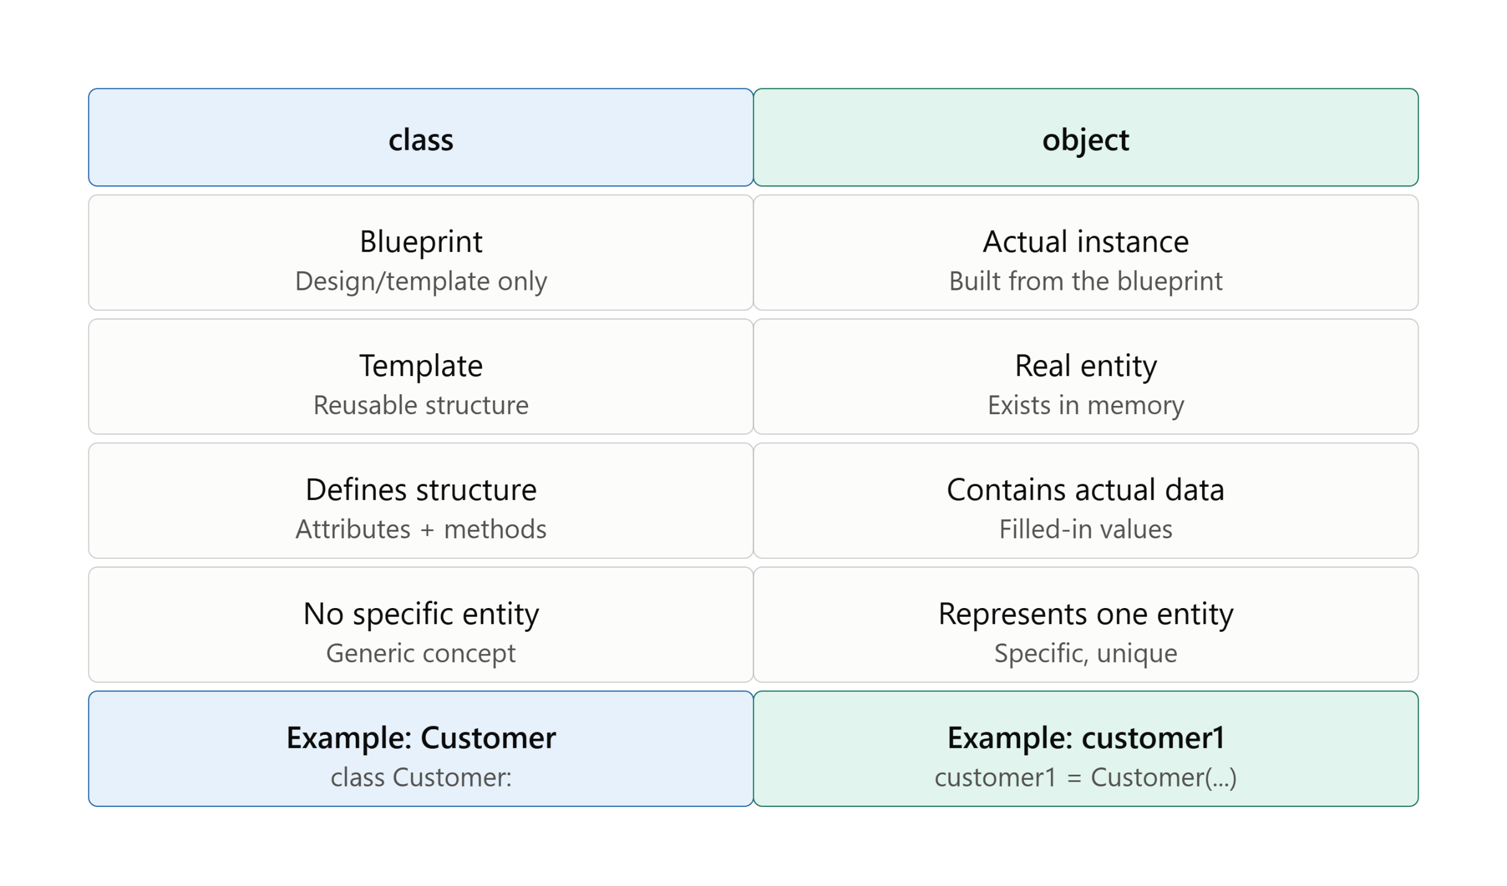

Slide 19
Class Activities: Student Practice
class Student:
def __init__(self, student_id, name, marks):
self.student_id = ____________
self.name = ____________
self.marks = ____________
def show_result(self):
print("ID:", ____________)
print("Name:", ____________)
print("Marks:", ____________)
# Create an object
student1 = Student(10, “KHALID", 85)
student1.____________() # call the method to display result

Slide 20
Class Activities: Student Practice
SOLUTION
class Student:
def __init__(self, student_id, name, marks):
self.student_id = student_id
self.name = name
self.marks = marks
def show_result(self):
print("ID:", self.student_id)
print("Name:", self.name)
print("Marks:", self.marks)
# Create an object
student1 = Student(10, “KHALID", 85)
student1.show_result() # call the method to display result

Slide 21
Find the Bug
class Employee:
def __init__(self, name, salary):
name = name
self.salary = salary
def give_bonus(amount)
self.salary += amount
emp1 = Employee("Sara", 40000)
emp1.give_bonus(5000)
print(emp1.salary)

Slide 22
Find the Bug (Solution )
class Employee:
def __init__(self, name, salary):
self.name = name # fixed: was missing "self."
self.salary = salary
def give_bonus(self, amount): # fixed: missing "self" parameter and missing colon ":"
self.salary += amount
emp1 = Employee("Sara", 40000)
emp1.give_bonus(5000)
print(emp1.salary)
The 3 bugs that were fixed:
name = name → should be self.name = name Without self., it's just a local variable that disappears once __init__ finishes — it never actually gets stored on the object.
def give_bonus(amount) → should be def give_bonus(self, amount) Every method inside a class needs self as its first parameter, so Python knows which object's data to update.
def give_bonus(amount) → missing colon : at the end Every function/method definition line must end with a colon, or Python throws a SyntaxError.

Slide 23
Summary: What We Learned
Class: a blueprint that defines what attributes and methods every object of that type will have, without holding any real data itself.
Object: an actual instance created from a class, with its own independent copy of the attributes (e.g. customer1 created from the Customer class).
Attribute: a piece of data stored inside an object, set through the constructor (e.g. name, price, balance).
Method: a function defined inside a class that lets an object perform an action or change its own data (e.g. deposit(), sell(), show_profile()).
__init__() : the constructor method that runs automatically the moment an object is created, used to set its starting attribute values.
self : a reference to "this specific object," letting Python know which object's data to read or update when multiple objects exist.

